Slide 1
Fun Box
Sai Deepika Gopala
Tejaswi Eerpina

Slide 2
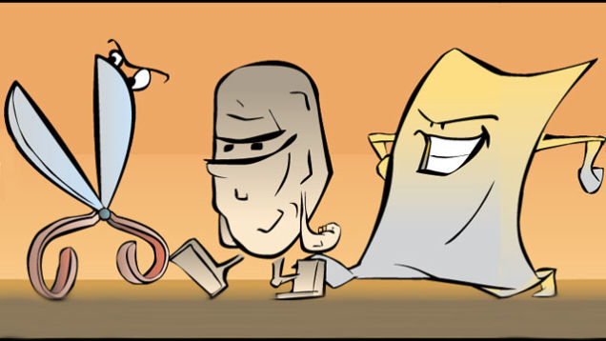

Theme
Contains two games
1.Rock,Paper and Scissors
2.Personality Predictor

Slide 3
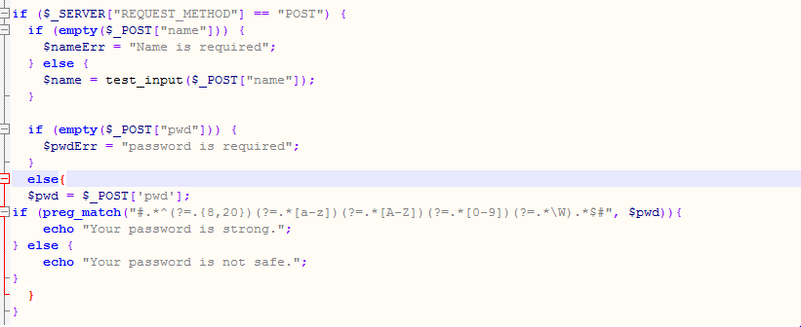
Login Page –PHP Code

Slide 4
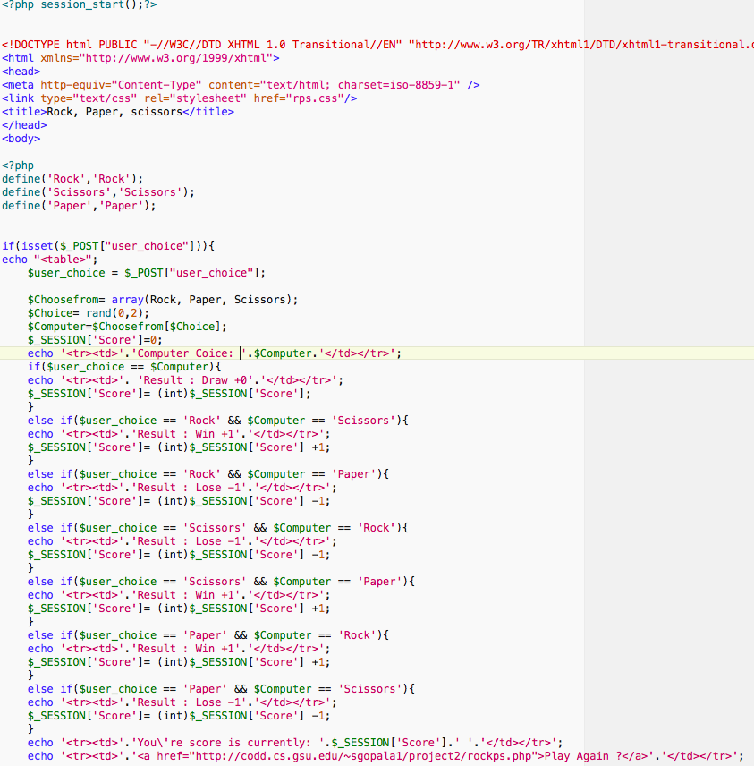
Rock,Paper and Scissors-php code

Slide 5
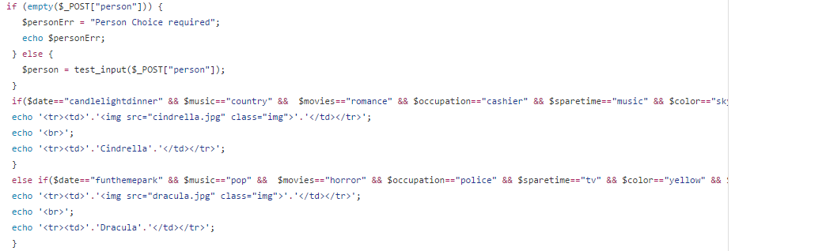
Personality Predictor-php code

Slide 6
QUERIES??

